Slide 1
Bilateral integration in virtual reality
by: Mykolas Kubilius (C20321456)

Slide 2
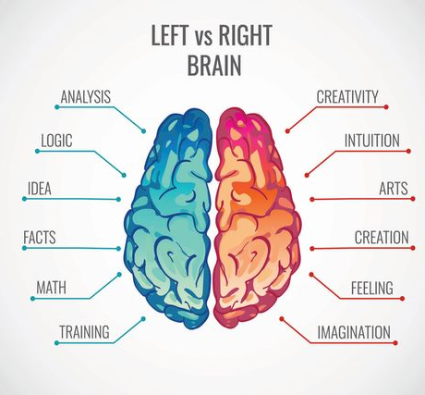
What is Bilateral Integration?
Ability to co-ordinate both sides of the body together
Left side is generally responsible for logic and language, while the right is responsible for creativity and intuition

Slide 3

Children and Bilateral Integration
Children with mental disabilities affected
Brain didn’t have time to adapt to basic movements
Skipping, Clapping, Drawing, Writing and coluring

Slide 4
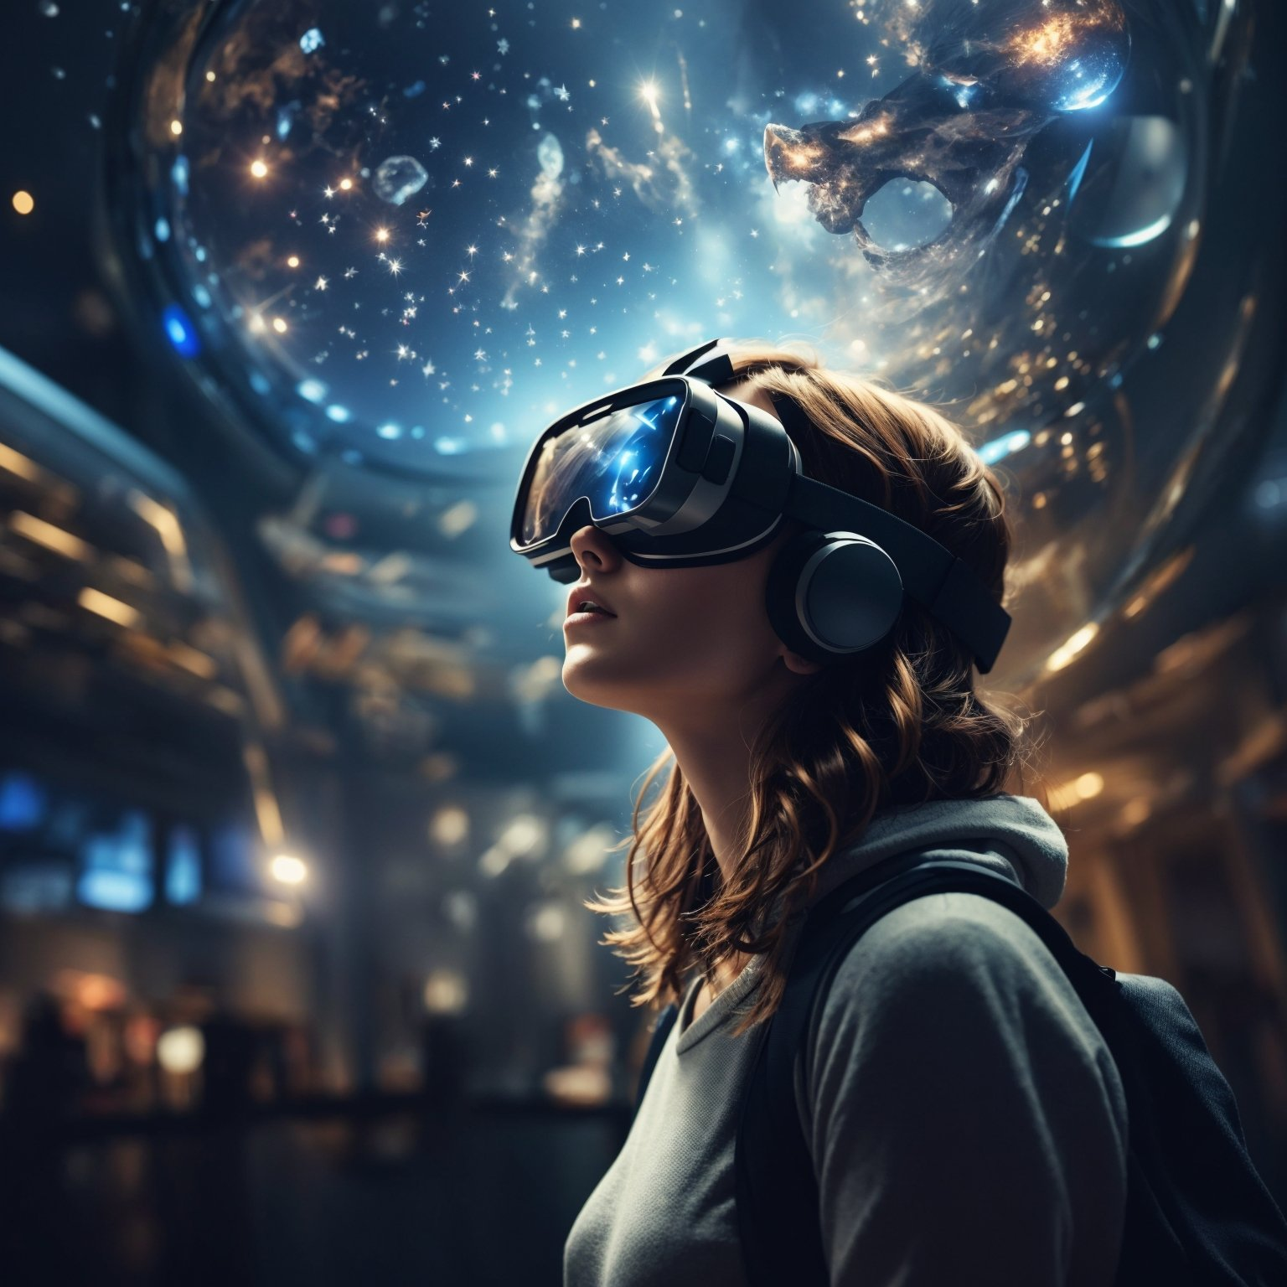
VR and Bilateral Integration
Offers a safe virtual environment
Used in teachings and education
Fun and entertaining
Exercises implemented into the virtual space

Slide 5
Demonstration

